Slide 1



Enhance the script
NHS Automation Team

Slide 2
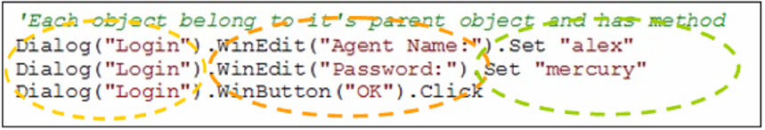
Enhance the script
Enhance the script
QTP utilizes an Object Oriented technology. This means that all objects in QuickTest belong to its hierarchy, i.e. WebEdit object belong to its Frame, Frame to its Table, Table to its Page, and Page to its Browser

Slide 3
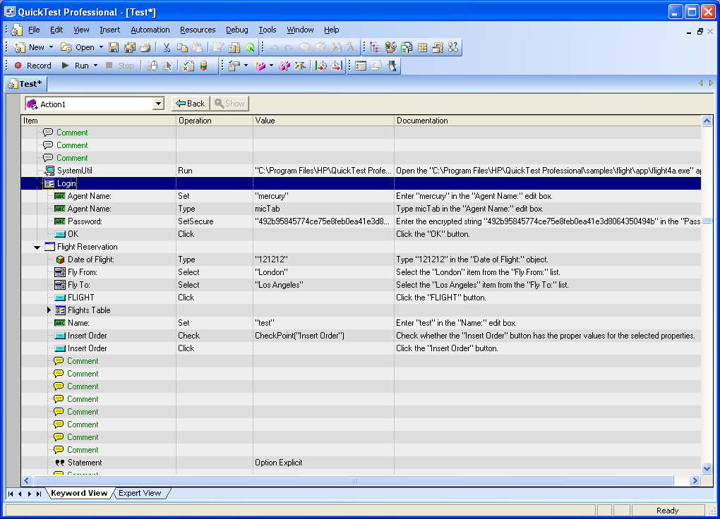
Enhance the script-Keyword View
Enhance the script
QuickTest 9.5 allows developing TestScripts without recording them (you just have to make sure that all Test Objects of Application Under Test are stored in the object repository or Programmatic Description of Objects are used).
Keyword View consists of six (6) components (columns): Item, Operation, Value, Documentation, Assignment, and Comments.

Slide 4
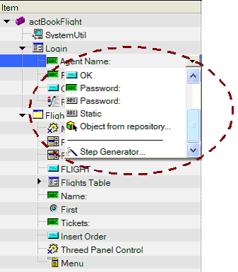
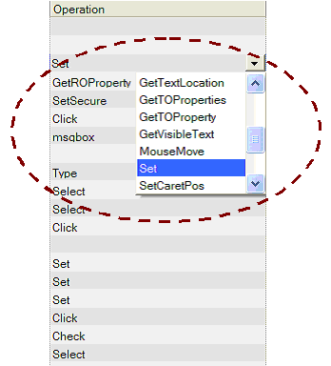
Enhance the script-Keyword View
Enhance the script
Item Column - contains the items on which you want to perform the
steps (test object, utility object, function call, or
statement). This column displays a hierarchical icon-
based tree
Steps performed within the same parent object are displayed under that
same object.

Slide 5
Step Generator
Enhance the script
The Step Generator utility enables us to add steps in your TestScript
that perform operations, using test object methods, utility object
methods, or function calls
Access Step Generator three ways:
By selecting Insert > Step Generator on QTP tool bar
By right-clicking on object you want to perform the method on in your Active Screen, Expert View, or Keyword View, and selecting Insert Step > Step Generator option in the sub-menu.
By selecting F7 hot key from either Keyword View or Expert View.

Slide 6
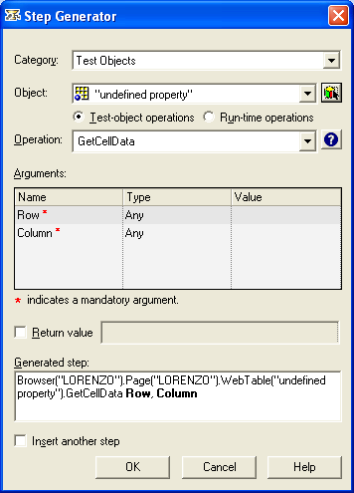
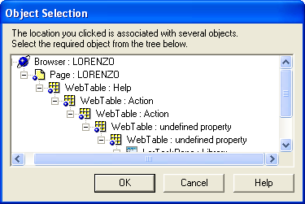
Step Generator
Enhance the script
If the location we clicked is associated with more than one object,
the Object Selection dialog box opens.
Select an object and click OK. The Step Generator dialog box
opens and displays the object from the selected step in the Object
box.

Slide 7
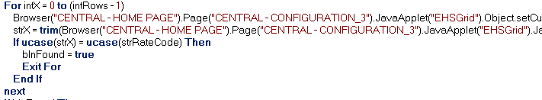
Using Conditional and Loop statements
Enhance the script
We can control the flow of your test or component with conditional
statements.
Example :

Slide 8
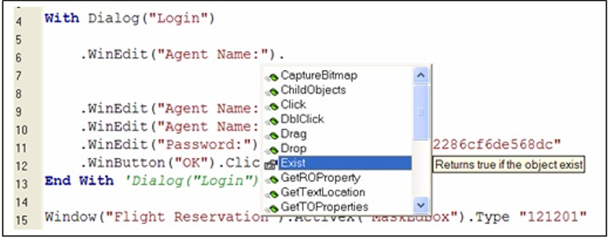
Insert methods manually
Enhance the script
You can insert methods in your script manually by selecting it from method list. If you type a dot ‘.’ following your object, QTP will invoke list of methods available for this object. Select desired method and follow the tool tips to insert arguments for this method.
In order to use object list, the object has to be captured in Object Repository.

Slide 9
Summary of the Topics Covered
Enhance the script
Enhance the script
Enhance the script-Keyword View
Step Generator
Using Conditional and Loop statements
Insert methods manually
Questions?

Slide 10

Thank You

